Slide 1
ONLINE BANKING SYSTEM
WASEEM AKRAM S.MD(150071601077)
GOKUL A(150071601078)
M.K.MOHAMMED AFSAR RAHUMAN
(150071601079)

Slide 2
DESCRIPTION
ONLINE BANKING SYSTEM software is a tool developed to help the people banking online and very conveniently. It also helps the admins of the bank to manage the customer database very easily and conveniently.

Slide 3
PROBLEM DESCRIPTION:
main problems that occur in traditional hotel management
1. Task allocation and Staff Management.
2. Over-Bankings, Under-Bankings and Dynamic charging Strategies.
3. Proper understanding and adoption of new technology.
4. Online Reputation Management.
5. Lack of a centralized system to manage all operations.

Slide 4
ADVANTAGE OF USING THIS SYSTEM OVER TRADITIONAL SYSTEM:
Speed up the process
Less Errors.
Less Errors.
Accurate Daily Revenue Reports
Nationality Report.
Privacy Protection.

Slide 5
System Requirements
Windows 10,8,7/Ubuntu/MAC OS
1GB RAM
250 GB HDD
INTEL i3 processor
DATABASE: MYSQL
PLATFORM:PHP 7.01
XAMPP

Slide 6
LANGUAGES USED
Front End : CSS, PHP,JAVASCRIPT,JQUERY,BOOTSTRAP,
Back End : My SQL

Slide 7
MODULES
USER MODULE
ADMINSTRATION MODULE

Slide 8
USER MODULE
In this module user can view the information of the website and he/she can also register for lodging in advance with fully advance payment. User has to login into the system for the registration. User can view only the front end of the website. This contains sub modules like information module, login module, contact module, registration module and reservation module.

Slide 9
ADMIN MODULE
In this module admin controls the whole project. This contains sub modules such as Admin login module, employee module, customer module and room status module. Administrator has an authority to handle the front end and also the back end process of the system.

Slide 10
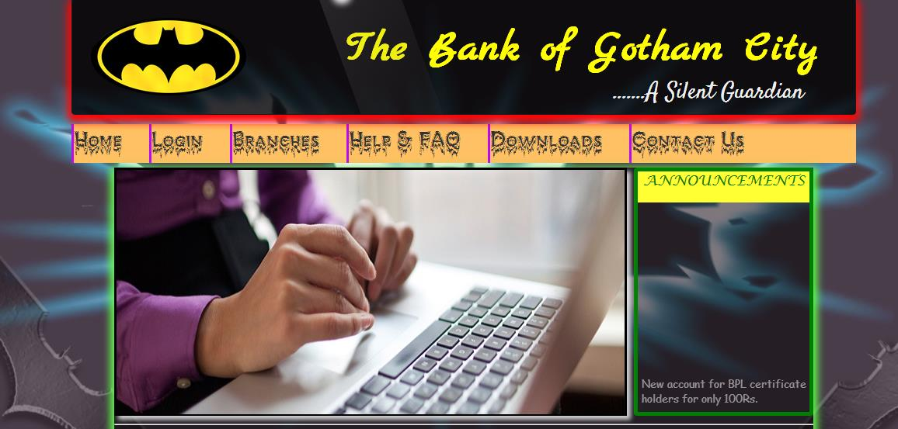
SCREENSHOTS-INDEX

Slide 11
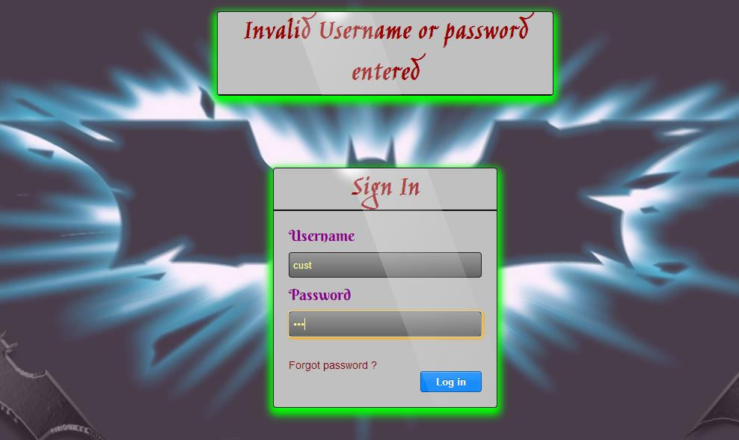
CONTINUE

Slide 12
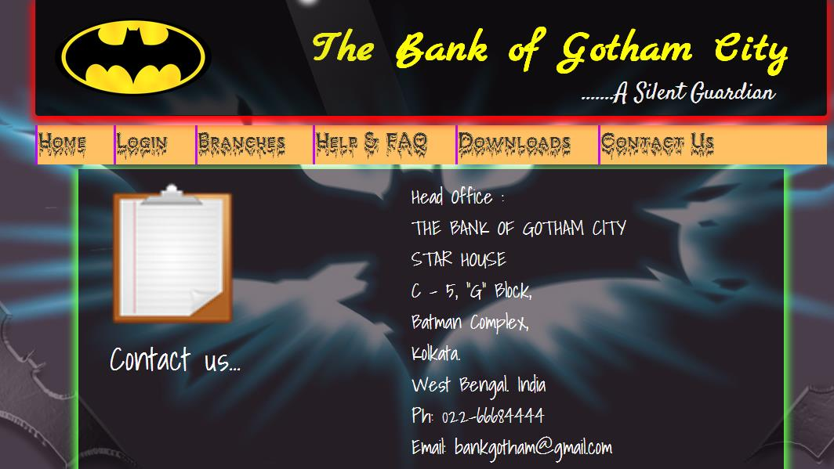
ABOUT

Slide 13
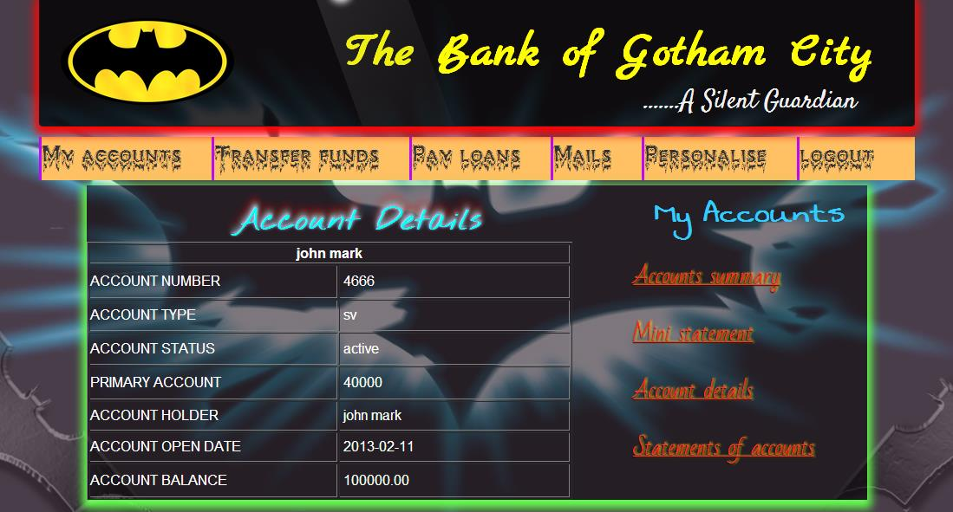
GALLERY

Slide 14
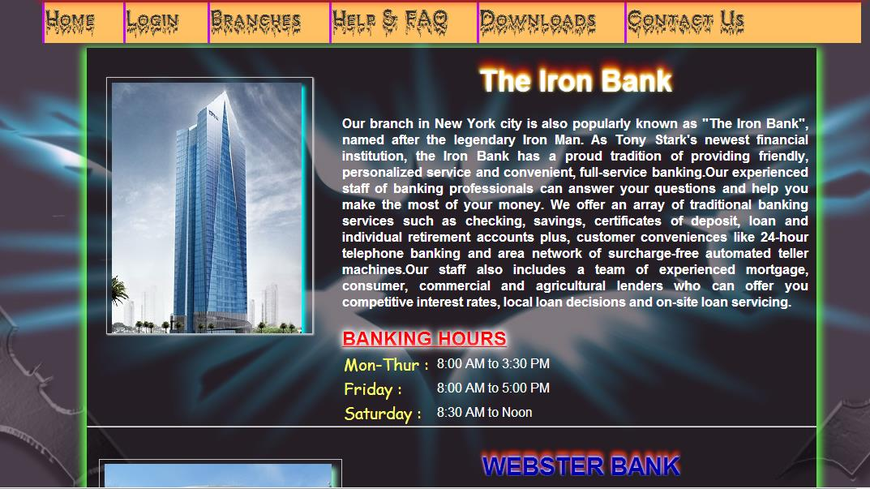
ROOMS

Slide 15
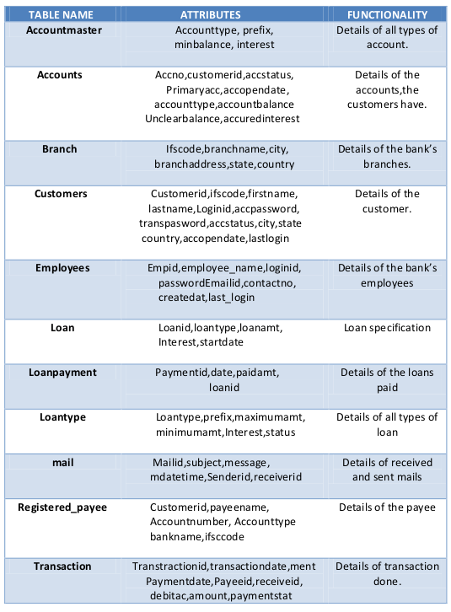
Features:

Slide 16
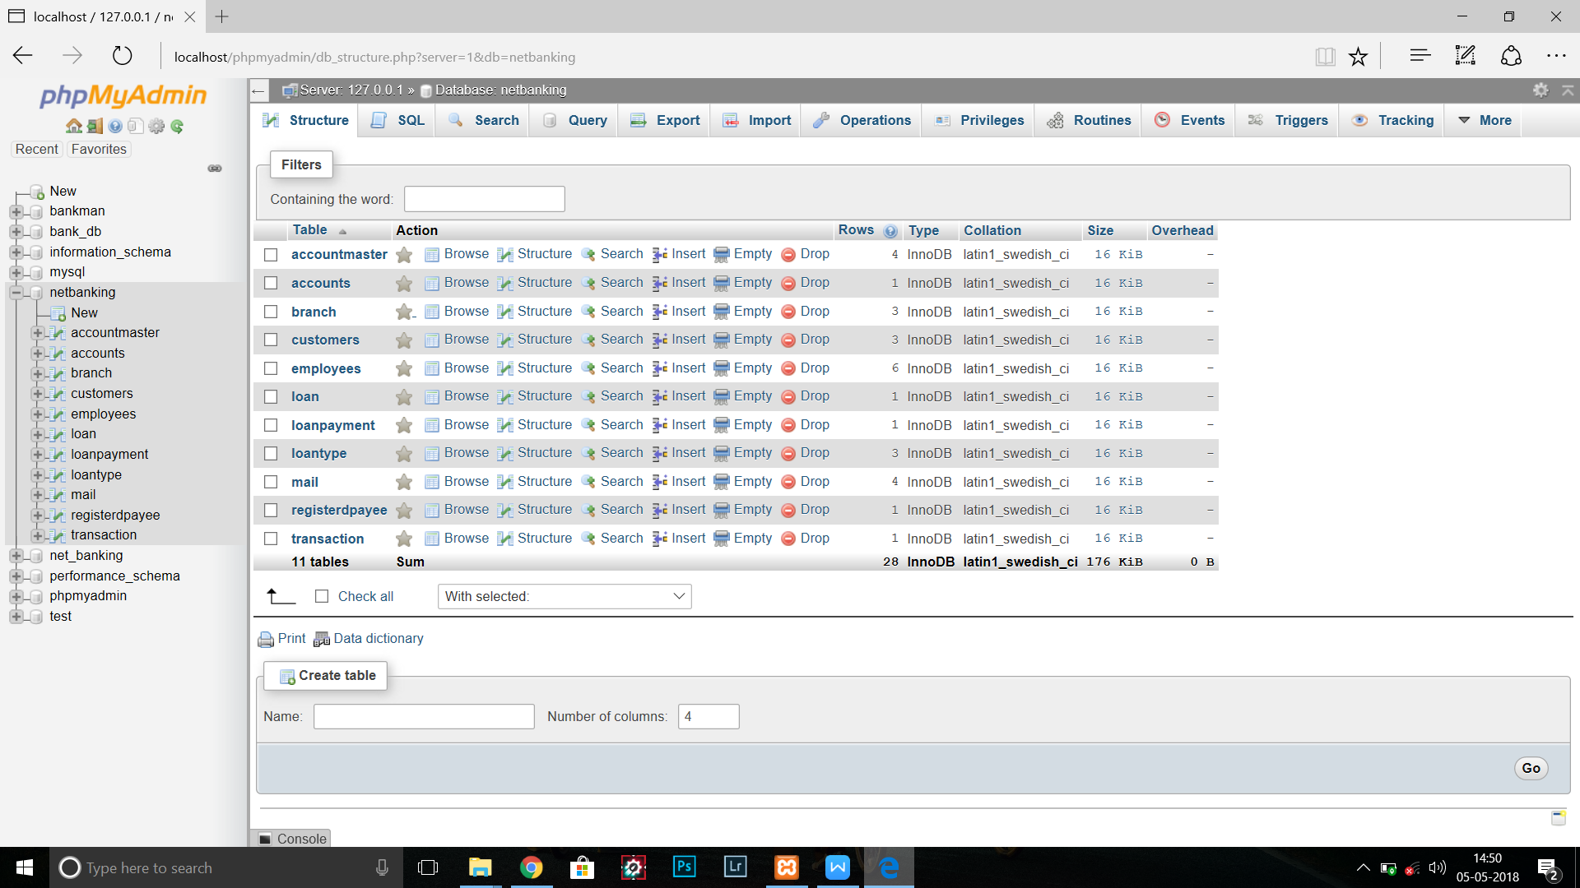
BACK END SCREENSHOTS

Slide 17
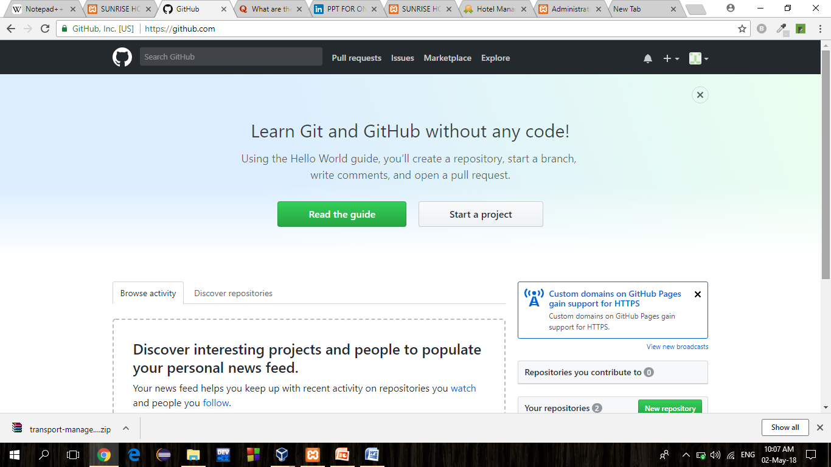
GITHUB

Slide 18
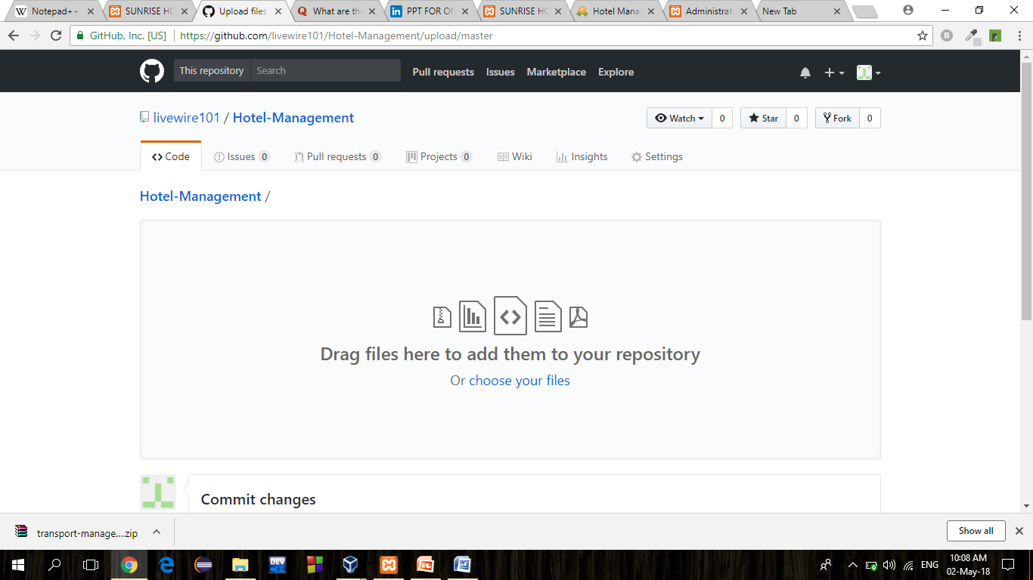
UPLAODING FILES

Slide 19
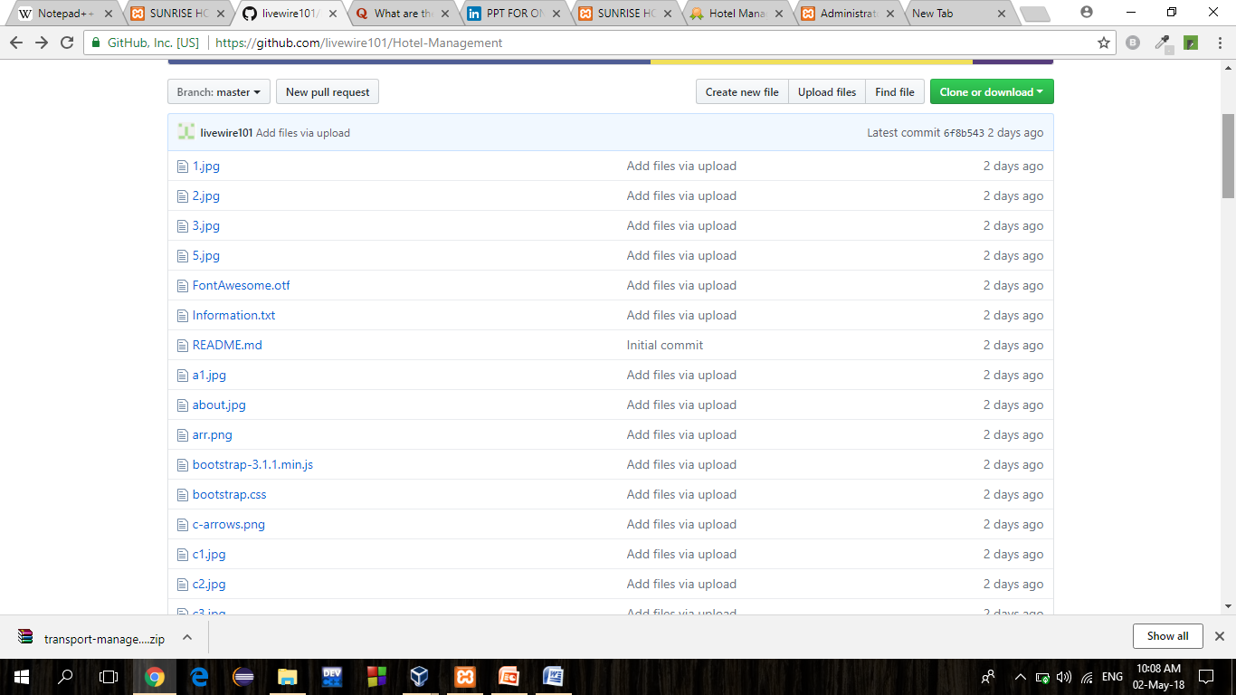
UPLOADING FILES

Slide 20
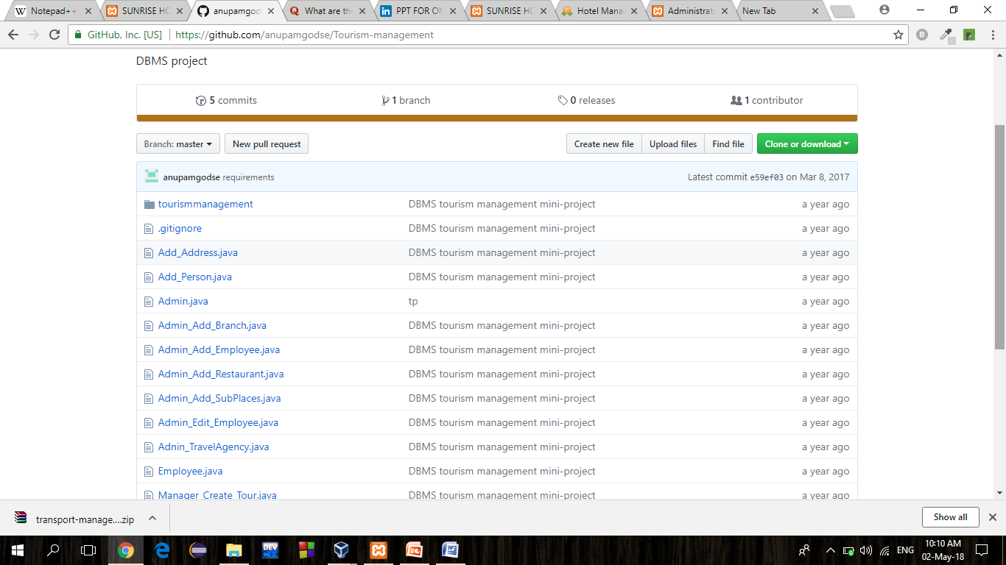
DOWNLOADING PROJECT

Slide 21
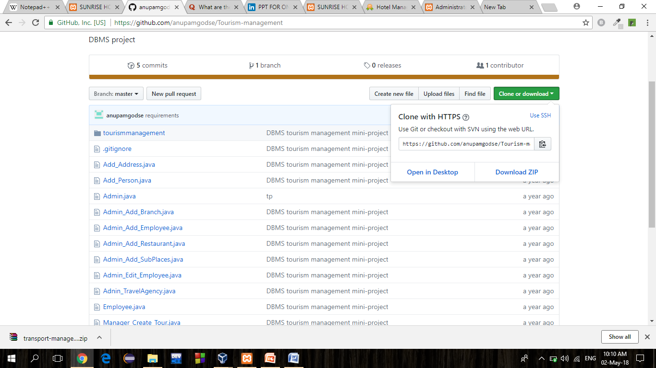
DOWNLAODING PROJECT

Slide 22
CONCLUSION
Thus this online banking system allows user to access online banking features anywhere and anytime and with ease and allows the admin of the bank to manage all the database of the customer with ease and without much trouble. The user data is also kept private and safe unlike the traditional way of storing the user information on a hand written file which the user information safe and secure The system uses all the open source softwares which make the system cost efficient.

Slide 23
THANK YOU

